Slide 1
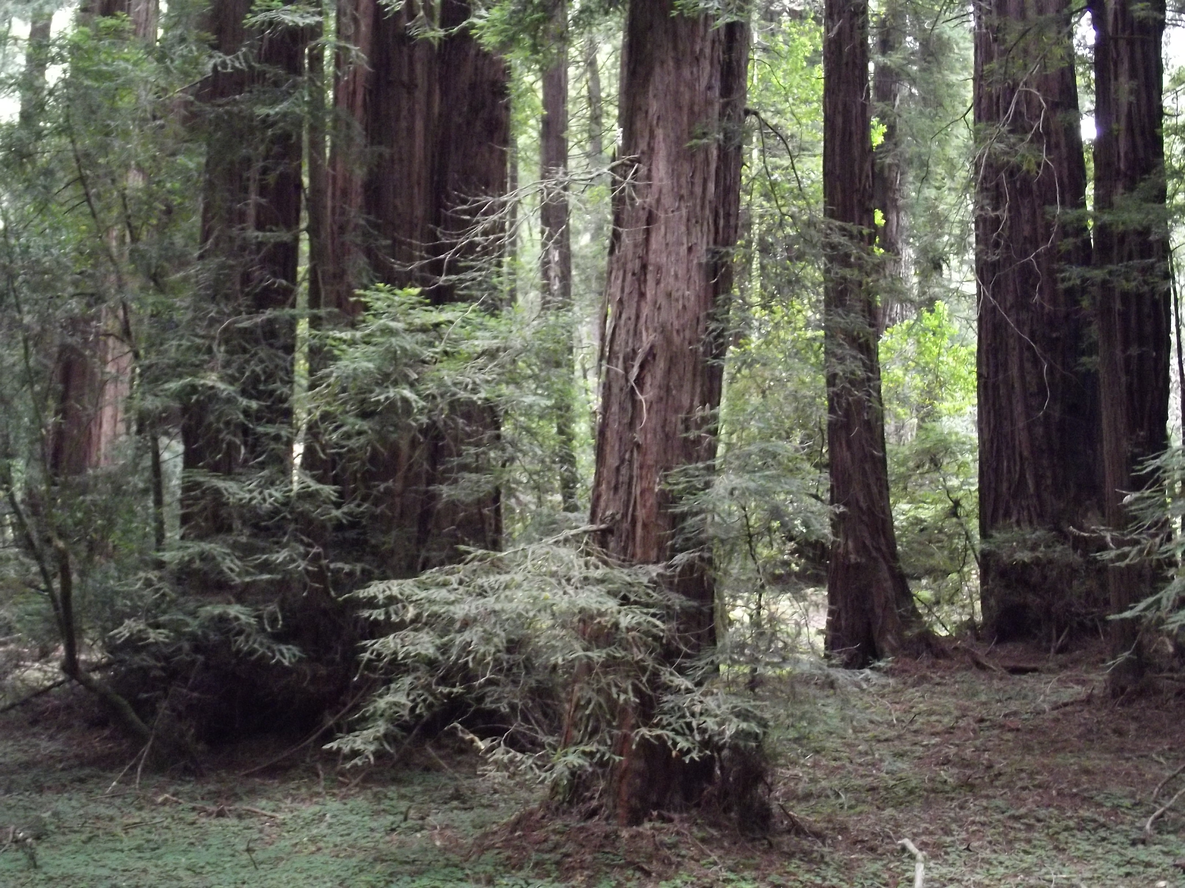
Restoring Populations
Translocation, captive breeding and the resurrection of extinct species.

Slide 2
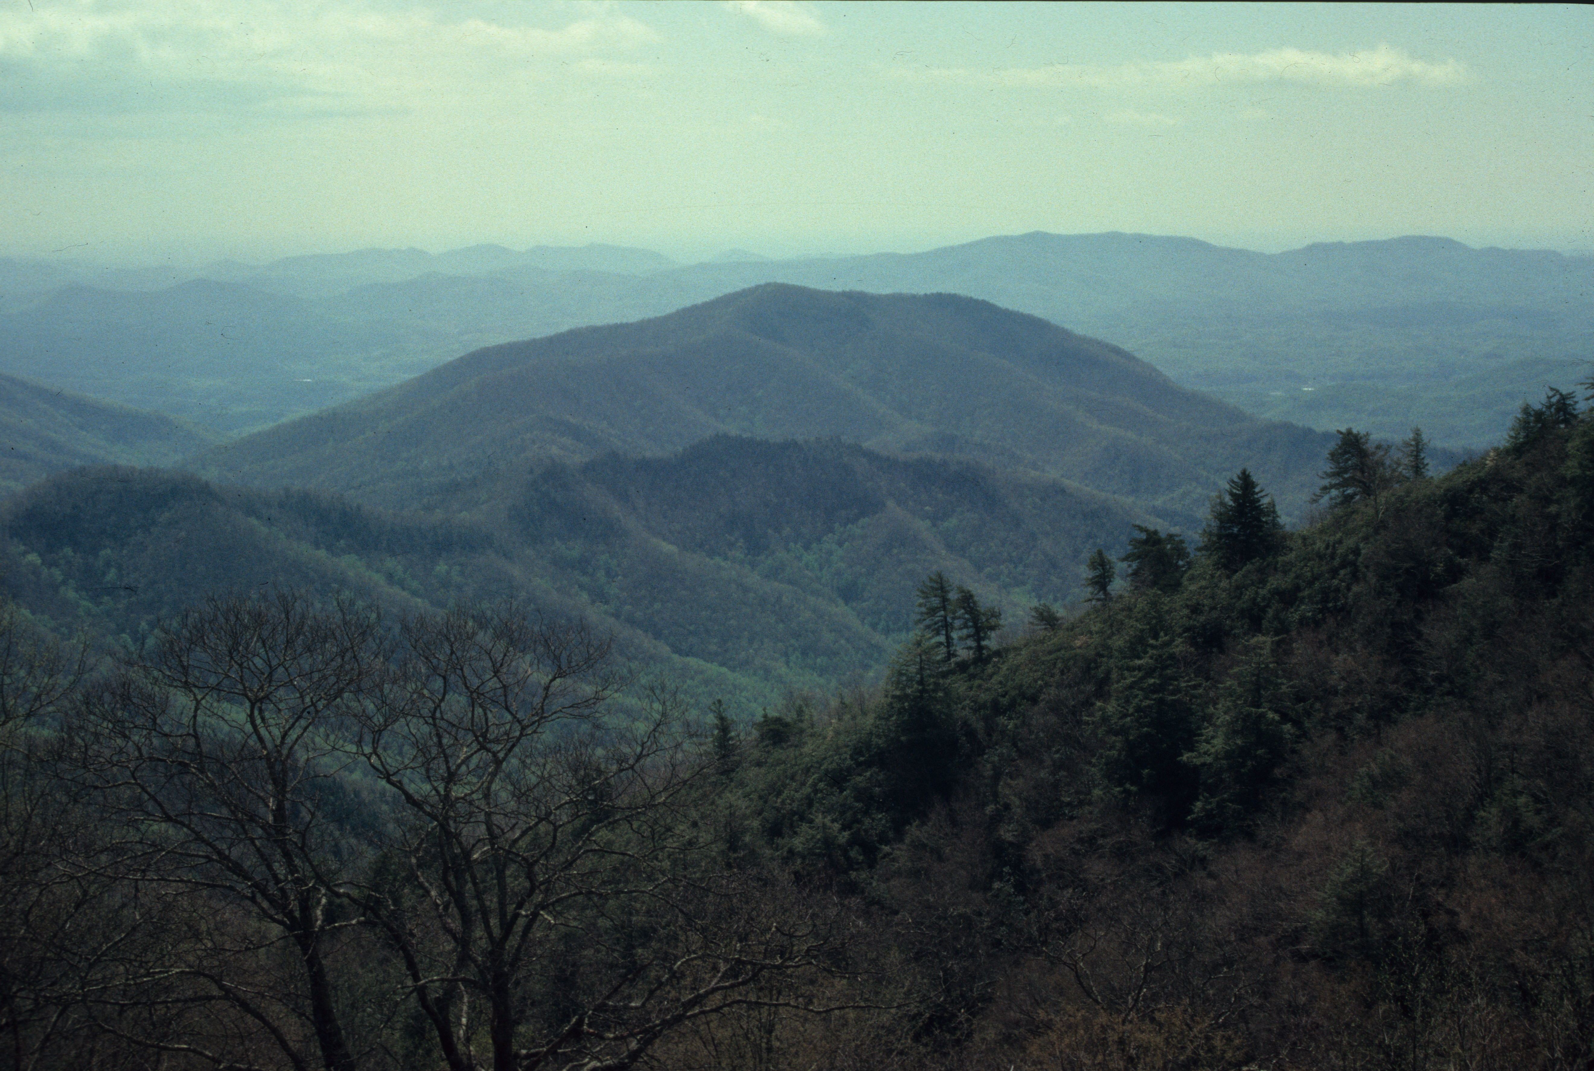
Excerpt from: Discover the Critical Habitats of Connecticut
In order to maintain all bird species within the larger forest ecosystem, at a minimum all of its habitat types must be represented in a list of critical habitats. Because the presence of particular habitats is in part a function of landscape features like elevation, slope, soil moisture, soil type and topography, the implication is also that tracts extensive enough to provide a variety of physical environments are required. Only extensive regions are likely to provide the range of physical variety necessary to support all species. Moreover, especially for those species existing at low densities, extensive tracts are essential for protecting populations large enough to be self-sustaining. So, a focus on critical habitats alone is insufficient for ensuring the persistence of biodiversity. A proper conservation approach preserves large tracts that include examples of a variety of critical habitats. In other words, habitats do not exist as discrete entities; they exist as features of larger ecosystems.

Slide 3
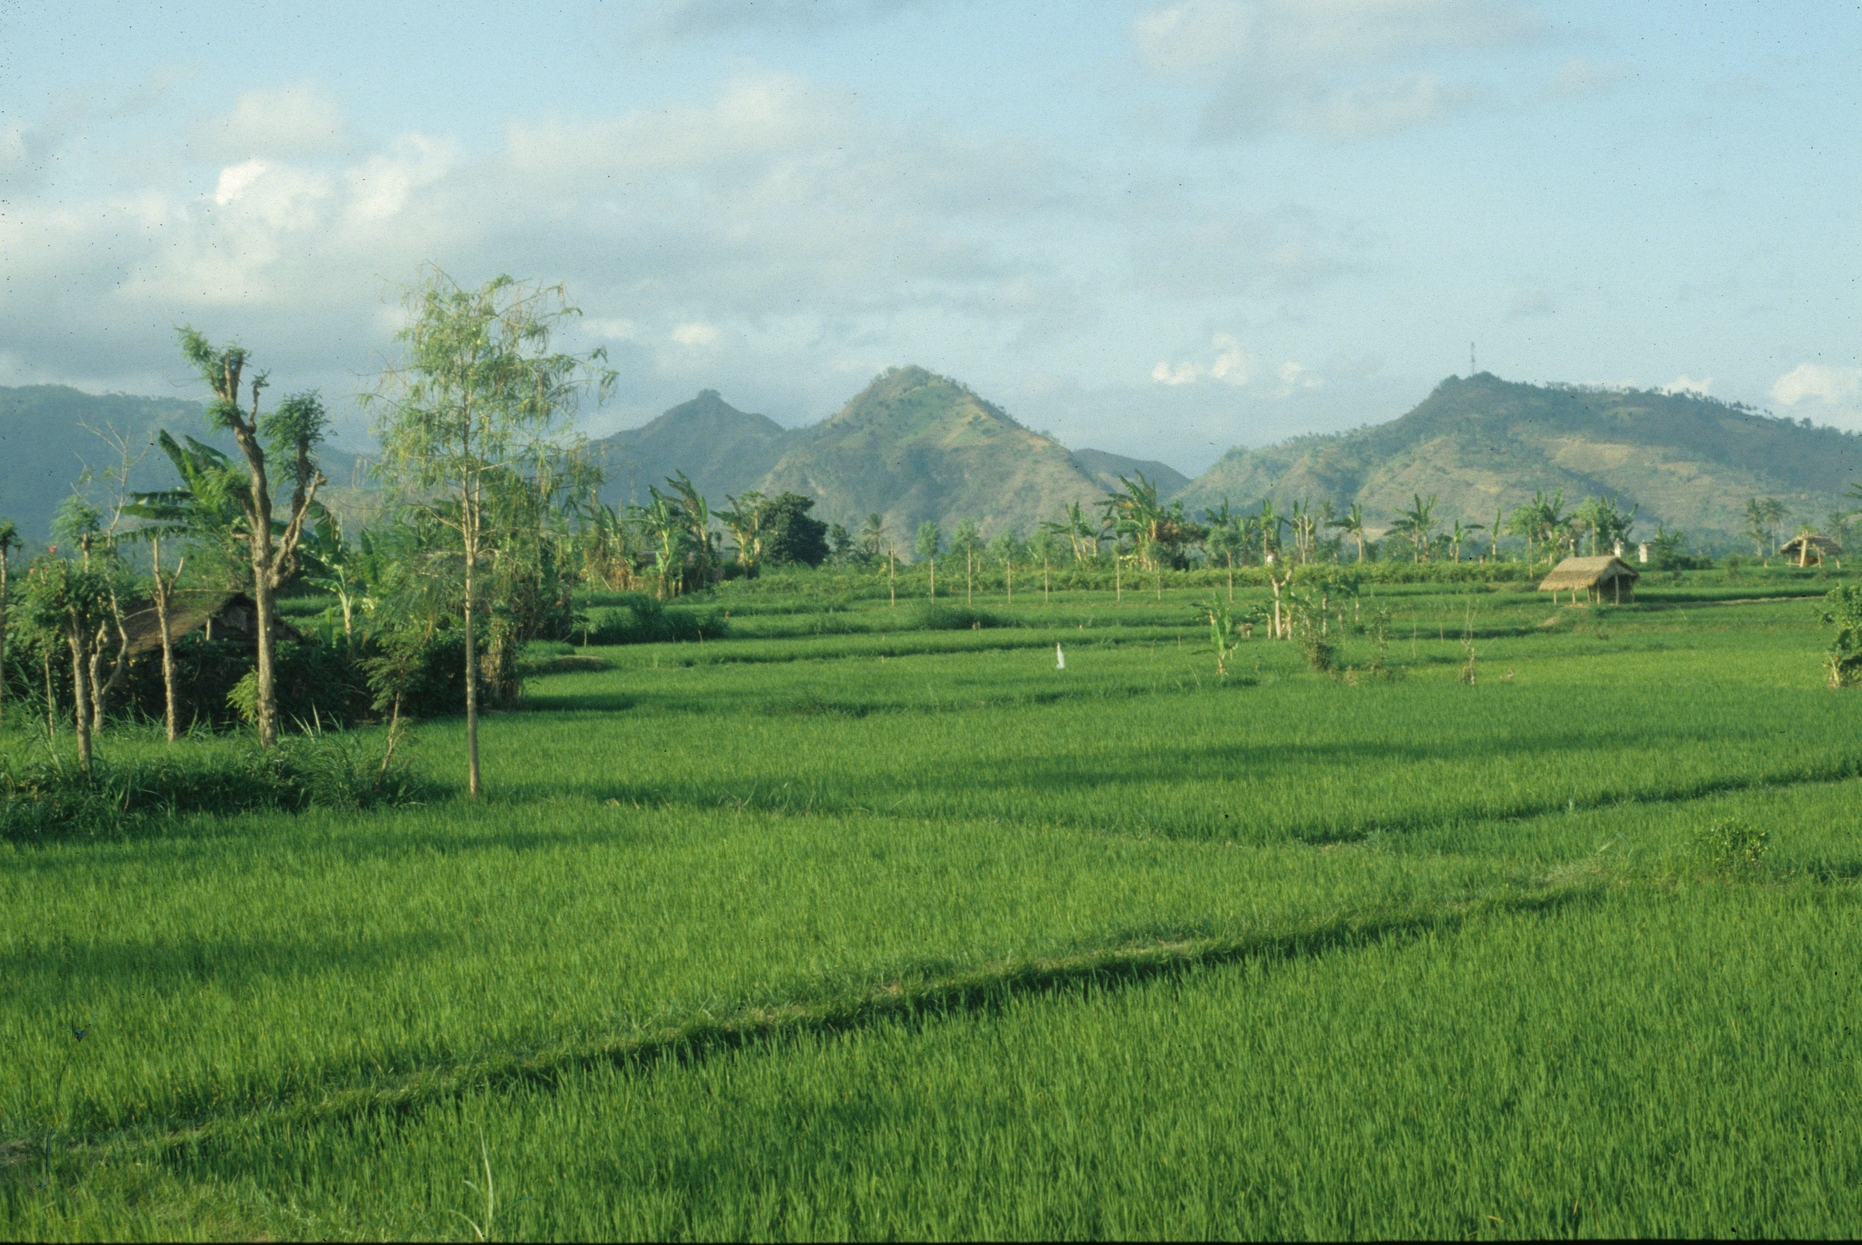
Objectives
Investigate the techniques and difficulties associated with captive breeding and translocating species.
Consider how community assembly phenomena may affect the outcome of translocation.
Examine approaches to re-assembling the genomes of extinct species.

Slide 4
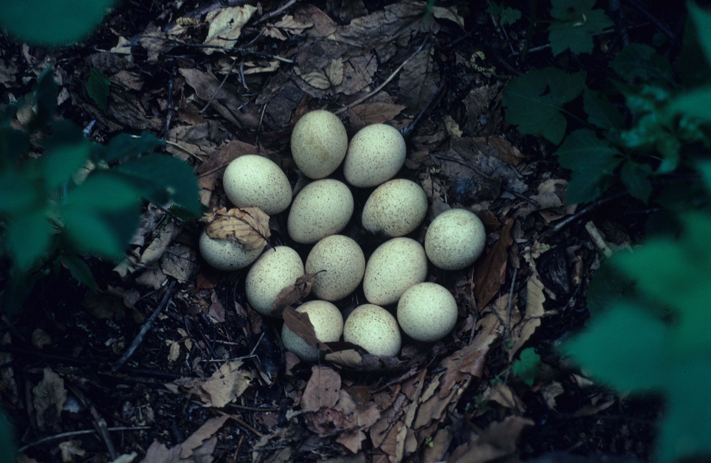
Translocation
Translocation is the process of moving species to new locations.
People have translocated species for millenia; it became a modern wildlife management strategy in the 19th century with attempts like the release prairie chickens into the East.
Case study: Wild Turkey
  By the early 19th century, the Wild Turkey had been extirpated from most of its range, and by 1900 its population numbered 30,000 range-wide.
  Initial attempts at re-establishing (not re-introducing) a Connecticut population began in the 1950s with the release of pen-reared birds.
  These naïve birds fared poorly and did not establish a population.
  Beginning in 1975, 356 wild-caught birds were released at 18 sites, which resulted in successful establishment.
  A population of 7,702 was estimated for primarily forested Connecticut landscapes for 2008.
Wild Turkeys were translocated to Connecticut from surviving populations in Pennsylvania.

Slide 5
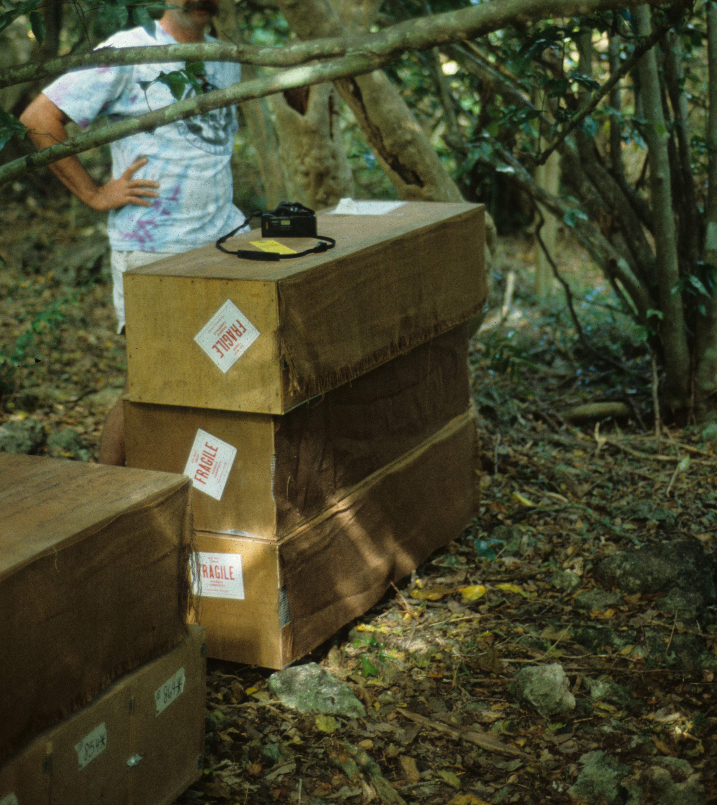
Translocation of Endangered Species
In the case of species that have small wild populations or are extinct in the wild, captive breeding is the only alternative for re-establishing species into the wild.
Case study: Guam Rail
  From 1984-1987, 21 birds of this flightless species were captured from the remaining population. Shortly thereafter, the species became extinct in the wild.
  They were brought to a captive-breeding facility that minimized human contact with the birds so that they would retain wild behavior.
  Captive-bred birds were then periodically released on the island of Rota, using the hypothesis that successful establishment is a stochastic event.
  Repeated releases were thought to improve the probability of success.
  Initial attempts in the early 1990s met with failure, as the birds still exhibited naïve behavior- they had trouble finding food and walked off cliffs.
Crated Guam Rails being prepared for release.

Slide 6
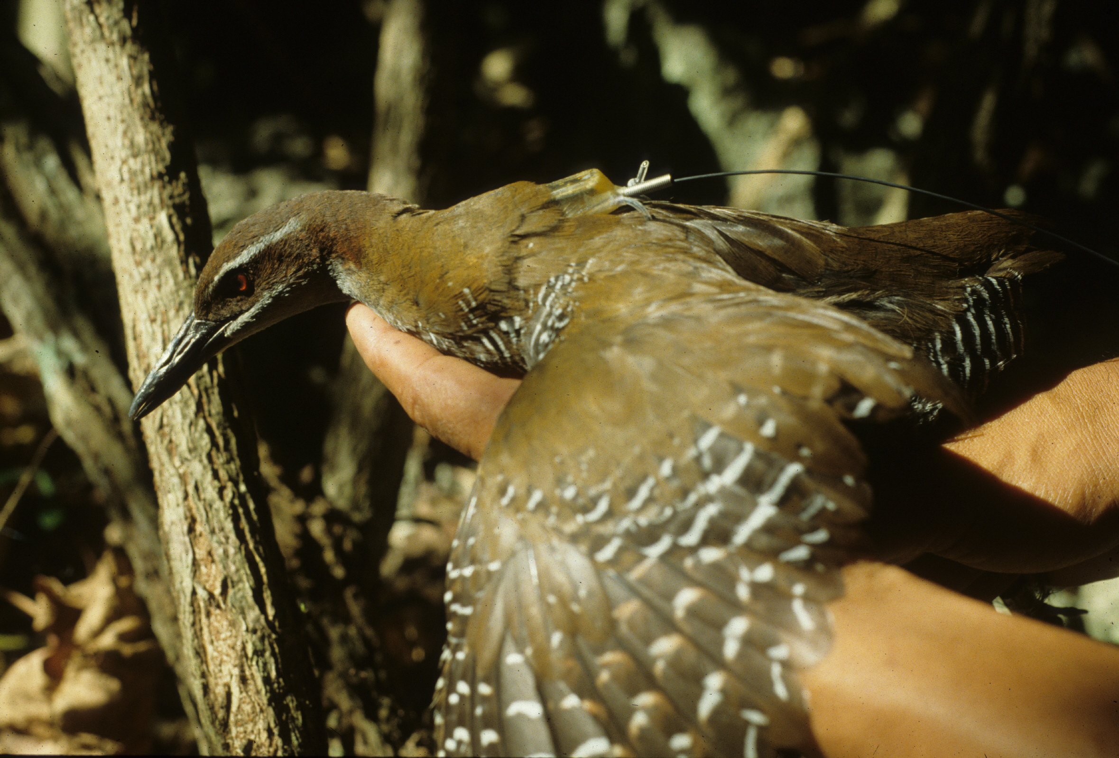
Guam Rail Translocation
With repeated attempts over multiple years, evidence indicates that a population is now established and beginning to prosper.
1,200 birds have now been released, and the present population on Rota, estimated at 170, is increasing.
Birds produce large clutches of eggs, breed year-round, and wild-hatched birds of wild parents have superior competitive skills.
A second population was also translocated to Cocos Island off the Guam coast after it had been cleared of introduced rats and cats.
However, these birds are all descended from the original 21 birds, so they have experienced a genetic bottleneck.
This may be less important in island populations, as they were originally established from few founders, so already had limited genetic diversity.
This radio-collared Guam Rail could have its movements and ultimate fate tracked.

Slide 7
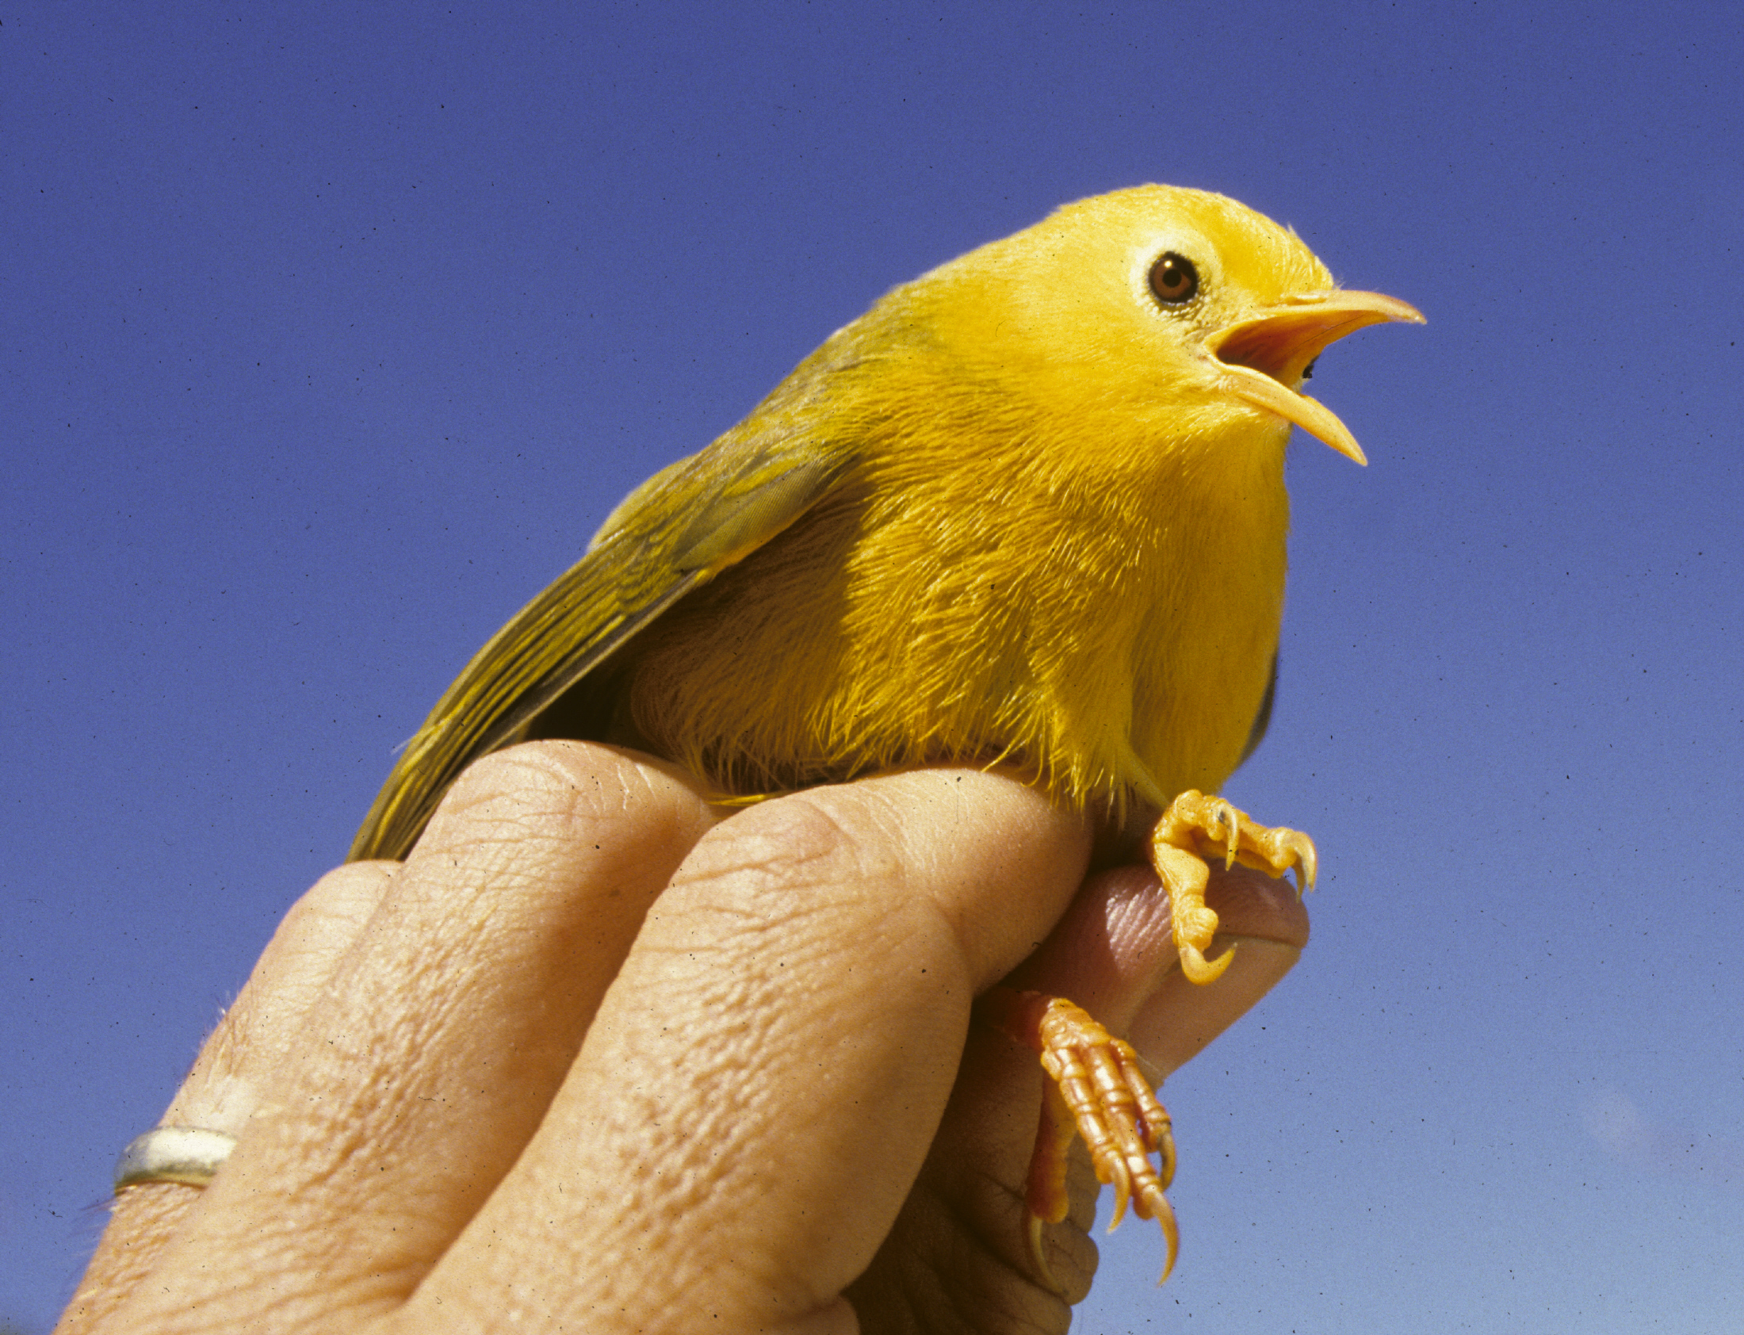
Community Assembly
The order in which species colonize habitats can influence the outcome of the colonization.
In nature, such colonizations were stochastic phenomena, so present communities represent the outcomes of those phenomena.
Socially subordinate species might, for example, be able to colonize before but not after the arrival of an ecologically similar but more dominant species.
When species are lost to communities, translocating them back into those communities may, therefore, not be as simple as releasing them back.
When species are lost, other species may also change population densities and expand their niches in such a way that the lost species may be at a competitive disadvantage for re-establishment.
The safest re-establishment efforts are likely to be those of species ecologically distinct from extant community members, as was the Guam Rail.
The Golden White-eye, in a single species genus endemic to Micronesia, evolved in isolation for perhaps a million years, co-evolving with community members over this time.

Slide 8
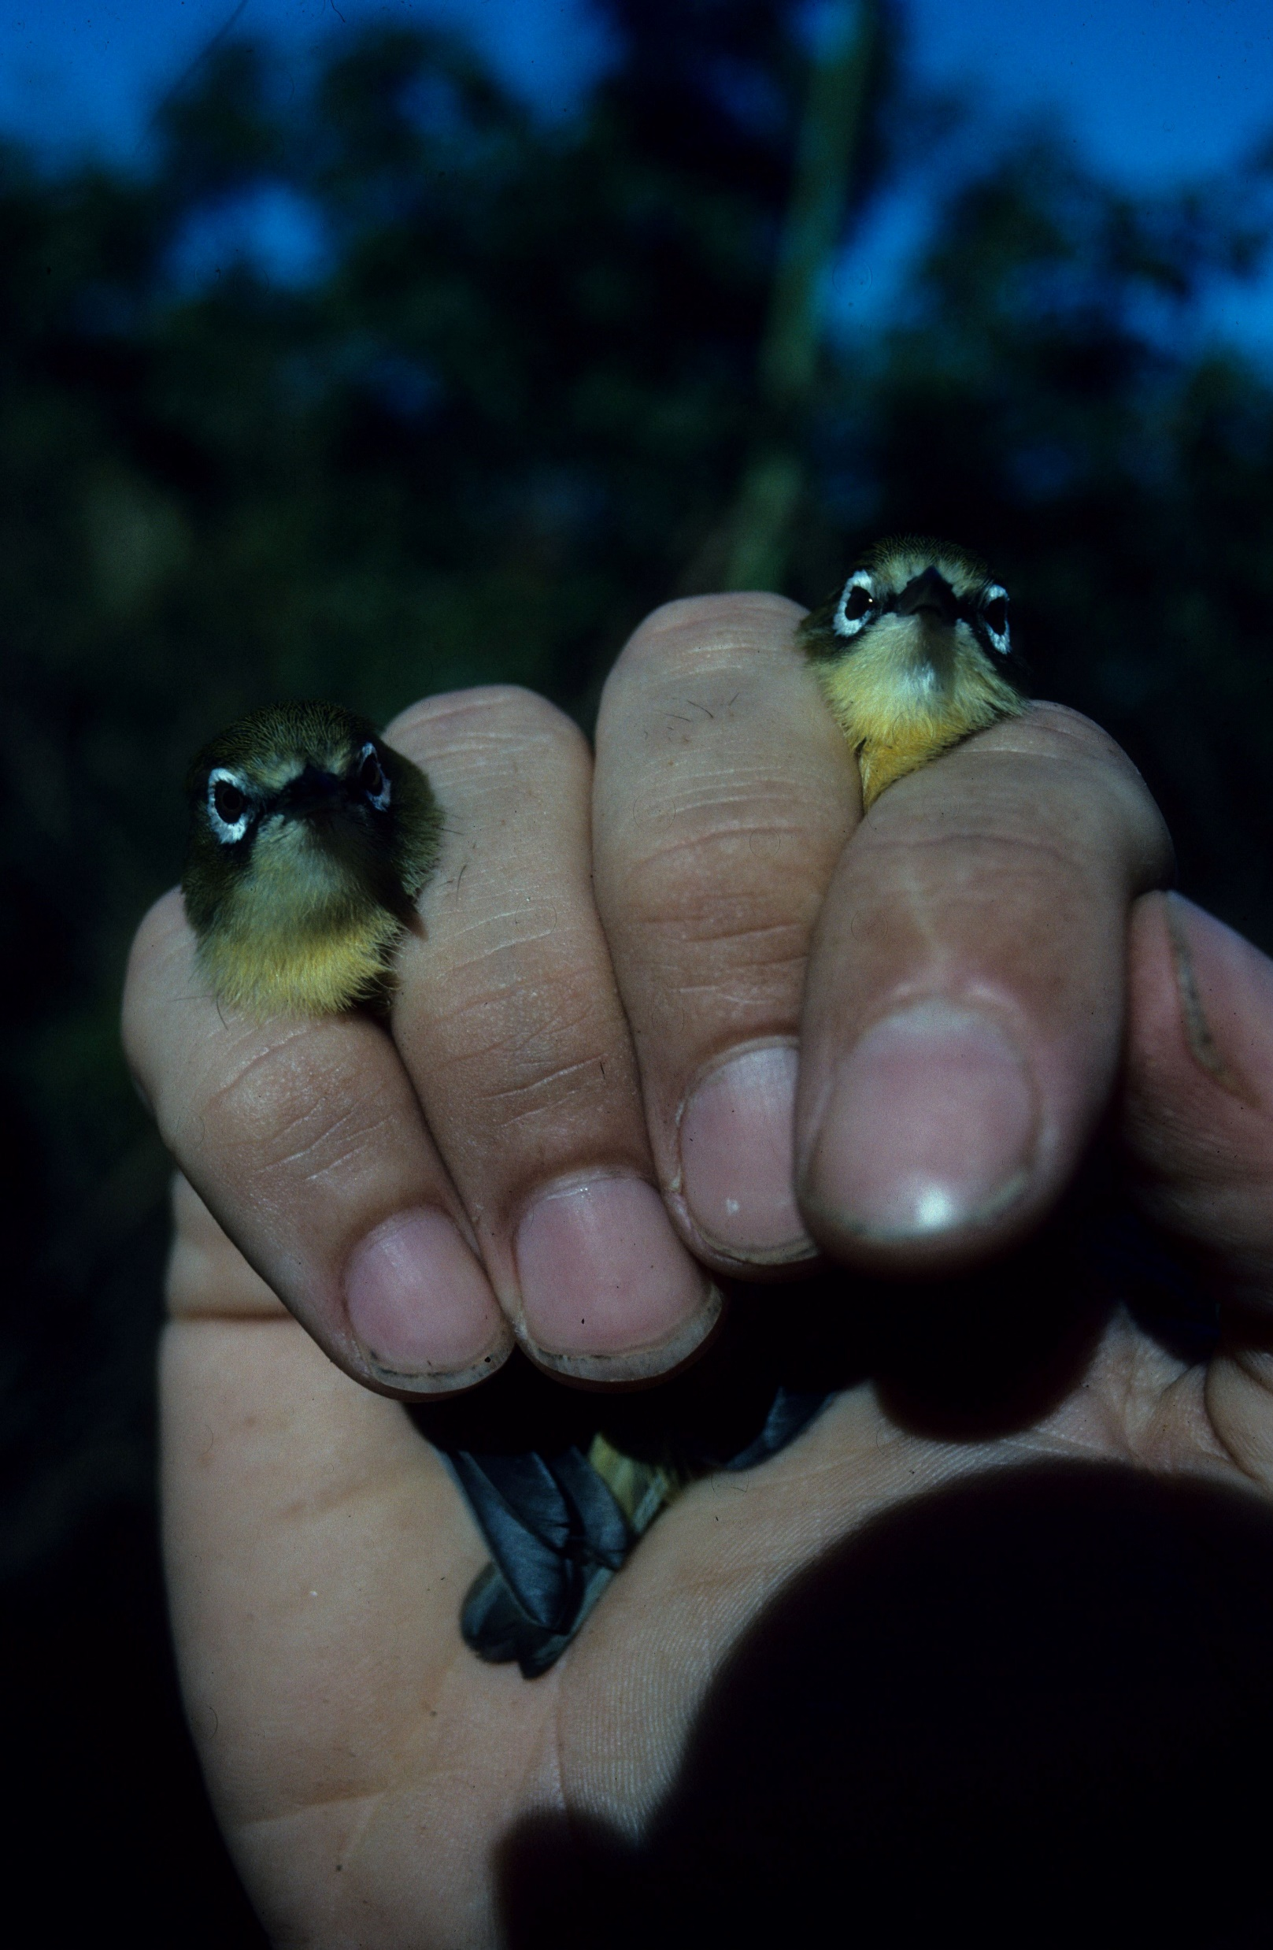
Captive Breeding
Bringing species into captivity for breeding so that they might be saved from extinction has proven a challenging pastime.
Even for species like white-eyes, different species of which are routinely kept at zoos, the probability of successful captive breeding for any individual species is not assured.
Case study: Rota White-eye
  Beginning in 1993, 5 female and 15 males were captured and transported to a captive breeding facility at the National Zoo.
  However, only two females produced fertile eggs, of which none were successfully raised by parents.
  One male was successfully hand-reared.
  By 2005, the last female died, leaving five males in captivity.
  Diet proved to be the weakness in the breeding program, as chick mortality was related to abnormal bone development.
  Efforts to manipulate calcium, vitamin and UV levels proved unsuccessful.
  Only with intensive research into the physiology of individual species is this program likely to achieve success.
White-eye species, like these juvenile and adult Bridled White-eyes, are generally captive bred successfully due to their adaptability.

Slide 9
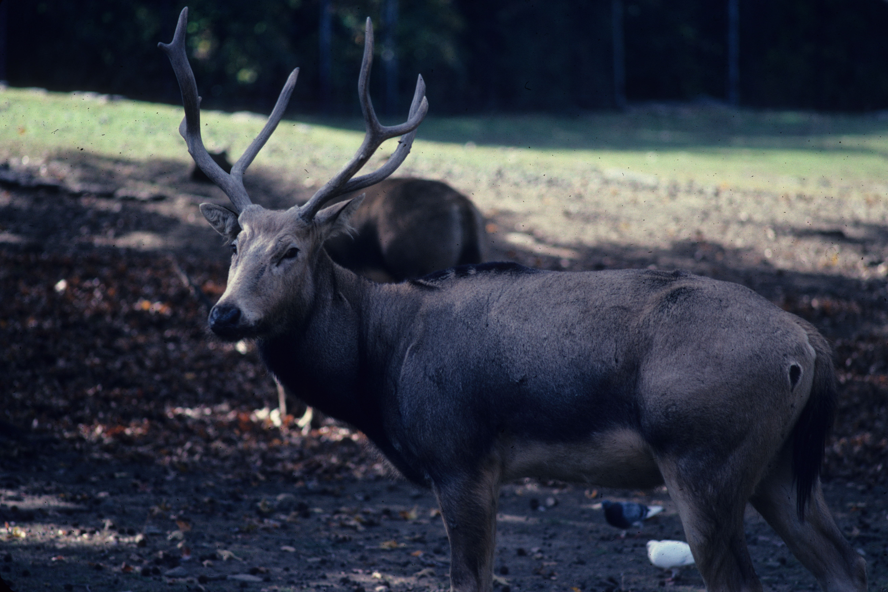
The Role of Zoos
Since the 19th century, captive breeding in zoos has been a component in the protection of species from extinction.
Case study: Pere David’s Deer
  This species of primarily wetlands was native to Manchuria.
  By 1860, one population remained inside the Nanyuan Imperial Hunting Ground, which had been isolated for over 1,000 years.
  During the 1899-1901 Boxer Rebellion, the hunting ground was stormed and the deer killed and eaten.
  Only deer transported to zoos in Europe survived. These were all transported to extensive Woburn Abby, England, where they bred naturally.
  From there, they were sent to zoos and game parks for captive breeding.
Pere David’s Deer, exhibiting its unusual antlers.
All of the over 5,000 individuals alive today are descended from the original few captives.
In 1985, the first attempts to re-establish animals into the native range began.
At present, there are 53 herds in China, with about 700 living in the wild.

Slide 10
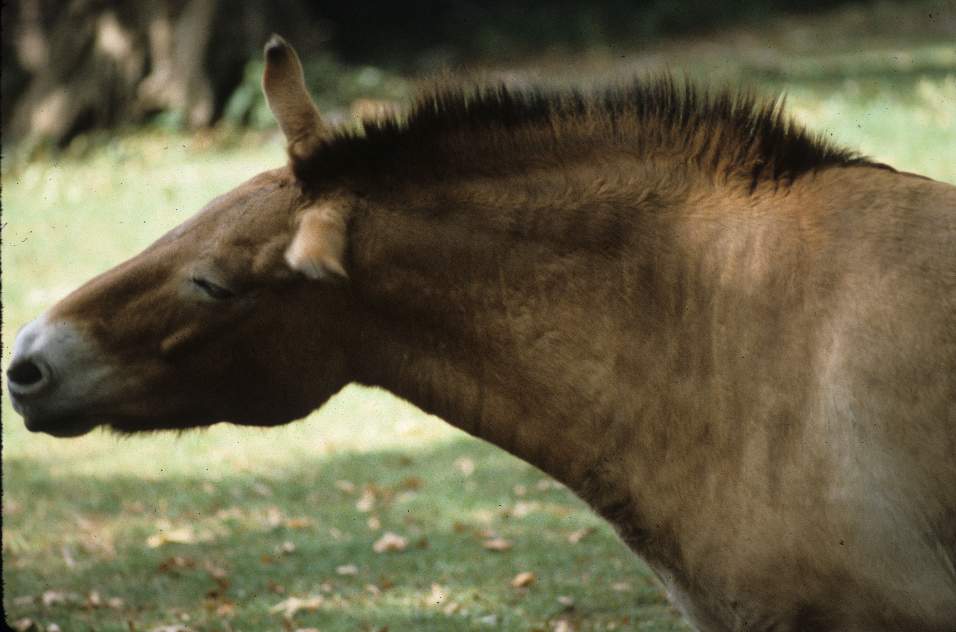
Resurrecting Extinct Species
Species like the ancestors of domestic cattle and horses are extinct in the wild.
Beginning in the1920s, German and Polish breeders hypothesized that, although extinct, the gene pool of these species survived in their domestic descendants.
They cross-bred the most primitive breeds over multiple generations in an attempt to re-assemble the original genome, producing horses and cattle resembling in color and ancestral markings the wild species.
However, geneticists caution that phenotype does not necessarily equal genotype.
In the case of the Eurasian Tarpan, whether it had a flowing mane like domestic horses is unclear, although the related Przewalski’s Horse shows a short mane like all other extant horse species.
All Przewalski’s Horses are descended from 12 captives and are possibly a distinct species of Tarpan.
The original color of the Tarpan was thought to be grullo, although genetic research indicates that a variety of coat colors existed in Pleistocene horses.

Slide 11
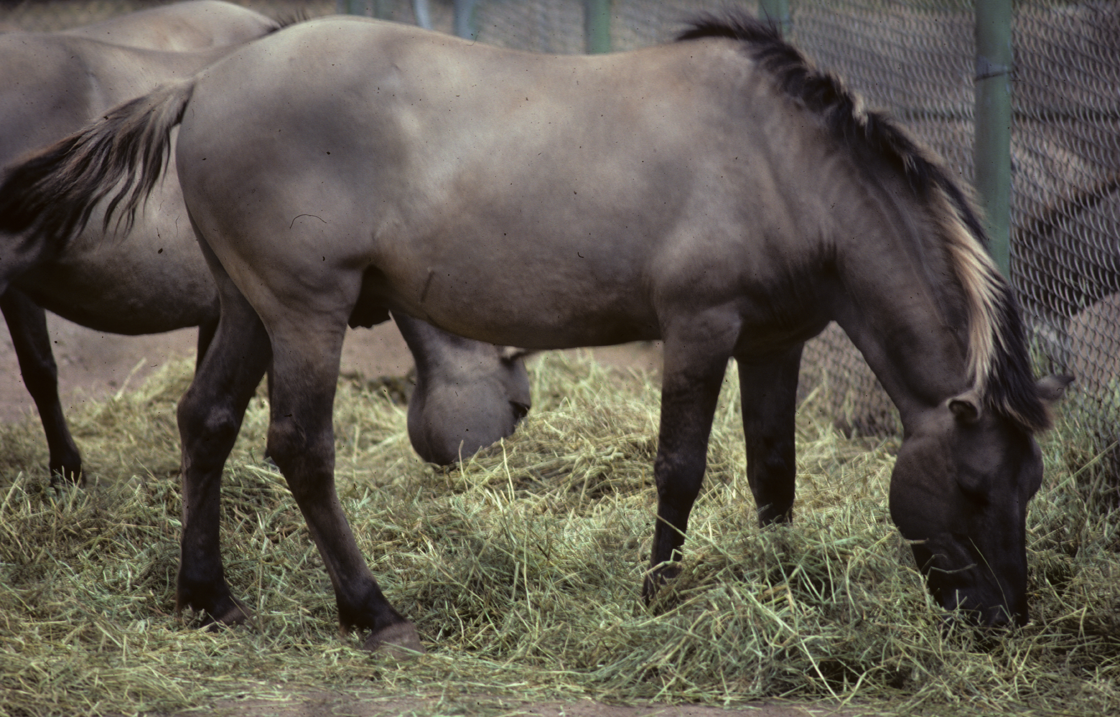
Re-assembling Genomes
Modern genetic techniques have permitted sequencing of the genomes of extinct species, including the long extinct Wooly Mammoth and Wooly Rhinoceros.
Using gene editing techniques, work is underway at Harvard to produce hybrid mammoth-elephants.
To date, 44 mammoth genes have been isolated for insertion into an Asian Elephant genome, which already had 99% of the same DNA as a mammoth.
This technique holds more promise than cloning, also being attempted, because ancient DNA is fragile and deteriorates quickly.
Cloning experiments have involved removing the DNA from frozen Mammoth cells and inserting it into mouse oocytes.
The goal is to find less damaged DNA and insert it into elephant oocytes.
The Heck Horse (named for its breeders), or resurrected Eurasian Tarpan, exhibiting a stocky build, grullo color and short mane. The white in the mane may be the result of crossing with zebras to produce a short mane.
Still other gene editing efforts are directed at resurrecting more recently extinct species like the Passenger Pigeon, for which better preserved DNA is available.

